Slide 1
GOOD MORNING

Slide 2
Iom Sudan
Established since 2000
IOM has 6 sub offices in Sudan
Khartoum head office – 3 Darfur – West Kordofan – South Kordofan - Abeyie
Khartoum head office
Algenenah sub office , West Darfur state
Alfasher sub office , North Darfur state
Nyala sub office, South Darfur state
Kadugoli sub office, South Kordofan state
Abeyie sub office, transitional area

Slide 3
Sub-offices

Slide 4
Running projects
Strengthening alternatives to irregular migration; A response to addressing the trafficking and smuggling of persons in Sudan.
As partners IOM/HCR to combat human trafficking – project seeks to address (4Ps) prevention, protection, prosecution & partnership.
Assist GoS to address phenomenon of human trafficking, kidnapping, smuggling & enhance protection of victims & identify solutions.
Capacity Building Support for Migration Management in Sudan
Enhance the technical and human resource capacity of migration-related agencies in Sudan to better manage migration and migration related information.
Enhancing Sudan’s Technical Capacity on Migration Governance
This project aims to provide support for the enhancement of the Government of Sudan’s Migration Governance by (i) further developing its border management technical skills and trainings; (ii) providing capacity building in migration legislation and (iii) by providing assistance to vulnerable migrants.

Slide 5
Running projects
Improved advocacy and protection of migrants and other vulnerable groups traveling through Sudan at risk of human trafficking, smuggling and kidnapping.
This project aims to assist migrants and host communities with critical humanitarian needs
Addressing vulnerable and irregular migrants and make informed choices on migration and increase their knowledge of a range of protection and health vulnerabilities.
Supporting victims of trafficking and other abuses.
Unaccompanied children will be given specialized protection
Enhancing protection and improving knowledge on the risk of irregular migration in Sudan.
project promotes safe migration and equips migrants with information and knowledge to prepare for their travel or make adequate choices

Slide 6
Running projects
Provide Assistance and protection to victims of trafficking and other at risk in the East of Sudan and Khartoum
This project also assists victims of trafficking and assures that they are identified, receive direct assistance and benefit from an improved protection environment, and prevent others from becoming targets of smuggling/trafficking crime syndicates
A Protection project- Supporting Government and NGO partners to protect migrants human rights along East African Route
Aims to strengthen governmental and non-governmental capacities to uphold and monitor migrants’ human rights, raise awareness on safe migration and provide sustainable and humane solutions to detained and/or stranded migrants
Temporary Return of Qualified Nationals
Migration and Development The project contributes to the development and implementation of national policies of the country by providing skills and opportunities and reduce the impact of the “Brain Drain”

Slide 7
Return Assistance
Receiving returnees from different EU countries such as Belgium, Greece, the Netherlands, Norway, Sweden, Switzerland, etc.
Australia & Asia such as Indonesia, PNG etc
From In region such a Egypt ,Libya, Tunisia etc.

Slide 8
Return Assistance
Assistance can be majorly divided into Cash and in kind – varies according to donors preference
Countries in cash | Countries in kind
Norway, Sweden, Indonesia | Netherlands, Greece, Switzerland, Australia, PNG, Egypt, Libya etc

Slide 9
Return Assistance
Different In kind packages can be used for one or more of the following categories limited to authorized budget from Sending missions:
Assistance for setting up a business – business setup
For Education or vocational training
For Job placement or capacity building in specific needed field for employment
Coverage of medical expenses
Temporary Accommodation – procurement of house as permanent

Slide 10
business setup
At least 2 counseling sessions with returnee for initiating business plan – depending on returnee’s expertise & knowledge
Prior assessment – visit to returnee’s suggested business location – recommendation provided
Collection of needed quotation for the procurement of tools, commodities, etc.
Initiating of business plan/IRP & share to sending mission for approval
Release of payment to selected supplier – returnee receive needed tools or commodities
Verification of business after 1 month/3 month
Evaluation & reporting to respective sending mission

Slide 11
Education / vocational training
Category is followed mostly by children in school
One counselling meeting with returnee/family
Assist returnee in evaluation of certificates
Suggest suitable schools/VTC to returnees individuals/family
Obtain needed quotation and release payments to school/vtc
Follow up, evaluate and report

Slide 12
Job placement
Meet & counsel returnee
Suggest needed extra courses related to returnee’s field of expertise – can be covered in case agreed upon with returnee
Help returnee to get a certificate for his acquired expertise in case returnee doesn’t have a certificate
Issued certificate help returnee to compete/find a job
Returnee to sit for an examination in his field of expertise and certificate would be issued with appropriate result
Returnee can repeat the examination in case of failure
An exemption for 50% of fees is offered from the center to IOM returnees
Relevant fees can be covered using the reintegration package
Full reintegration package can be released when returnee finds a job and support us with job contract

Slide 13
Job placement
Authorized package under this category can be released to cover following possible needs;
building capacity courses if needed
Fees for issuance of certificates after examination (related to VTC)
Coverage of returnee’s resettlement needs (upon presenting of work contract) such as
Coverage of rents for accommodation
Purchase of vehicle/moto bike etc. for transportation
Purchase of furniture – electrical instruments such fridge
Cash salary support

Slide 14
Medical assistance
Coverage of medical bills
Cash for special food authorized by doctor to patient returnee .

Slide 15
Return from Norway
Provide arrival / onward assistance to returnees when required after receiving relevant ABN
Meet returnee – check TD/ID and signed eligibility prove
Ask returnee to sign monitoring request in case a monitoring has been required by IOM Norway/donor
Prepare payments
Call returnees to collect their payments
Payment is done through cheques to Bank

Slide 16
Return from Norway- challenges
Returnees argue/push too much for either
Receive their entitlements in USD OR
Receive their entitlements using black market exchange rates
In supportive during monitoring despite acceptance and signing of relevant documents
In supportive to stories of return required.

Slide 17
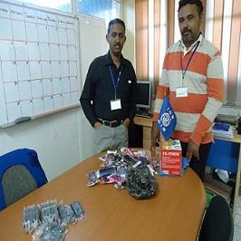
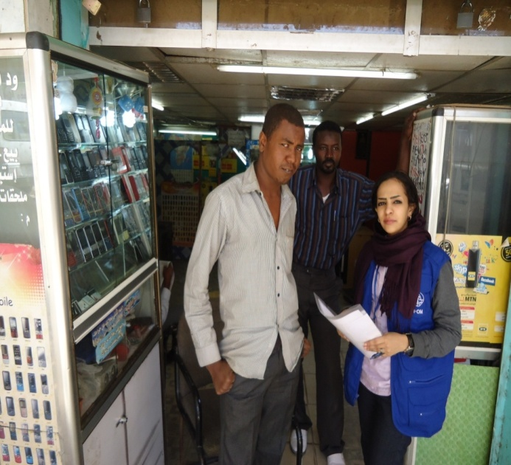
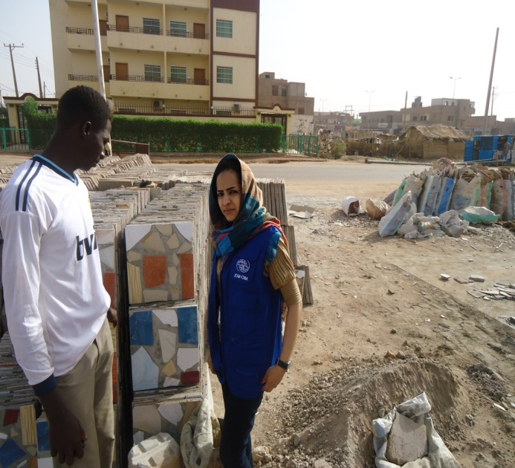
Photos for ARR Activities IOM

Slide 18
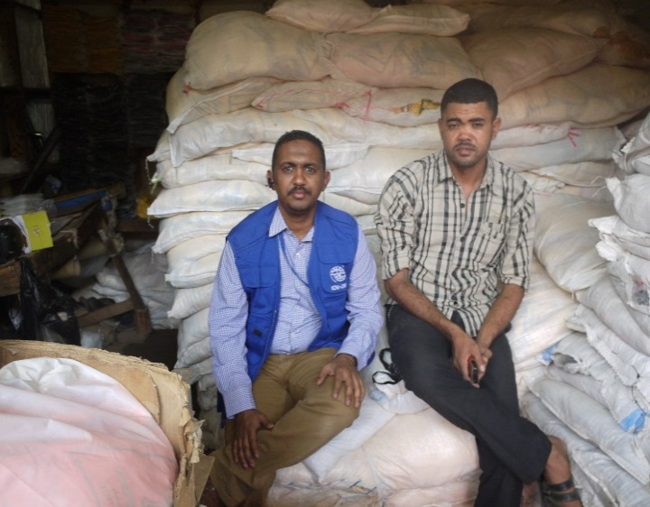
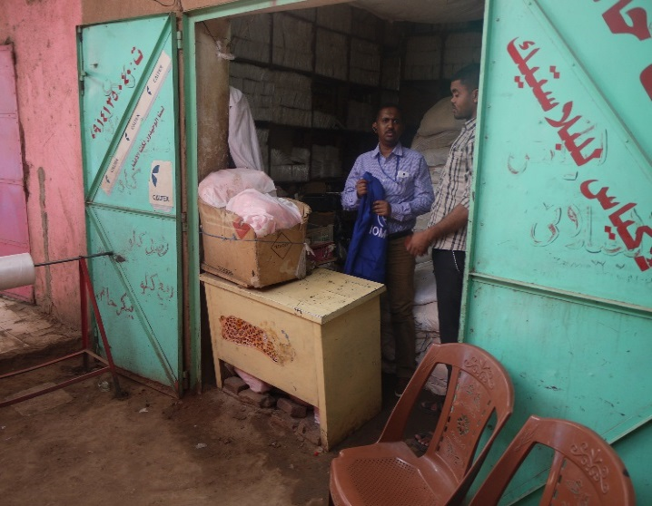
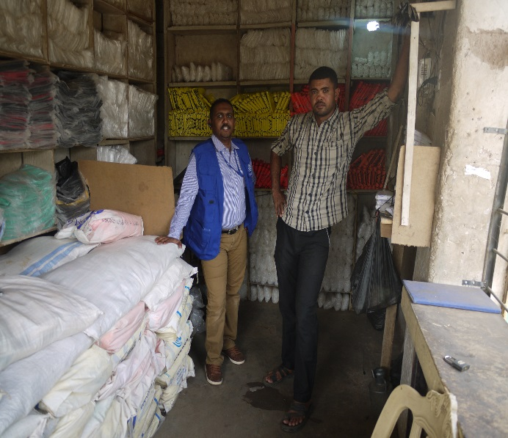
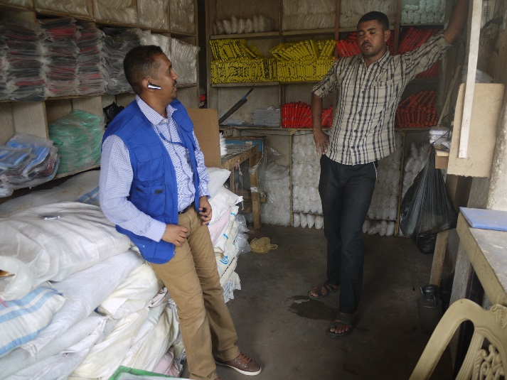
Stories of return

Slide 19
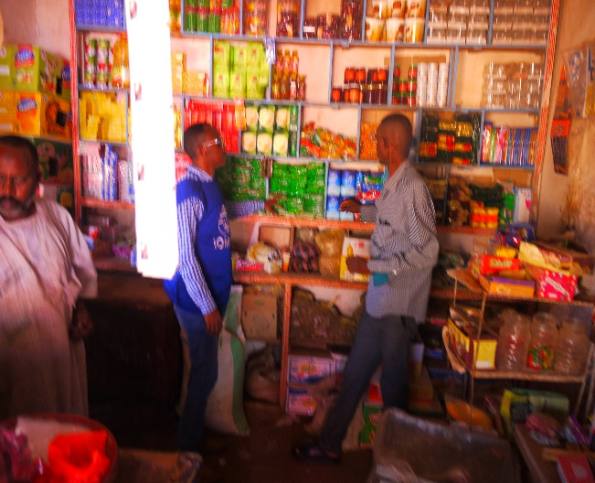
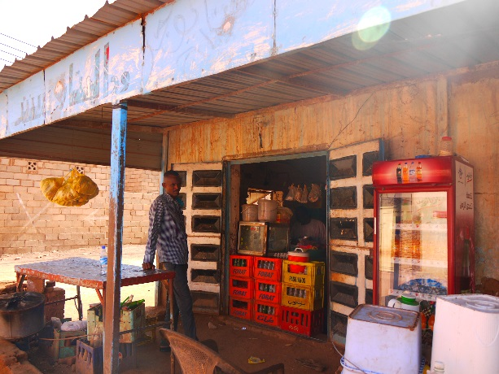
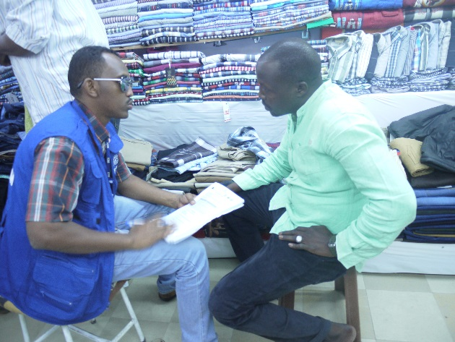
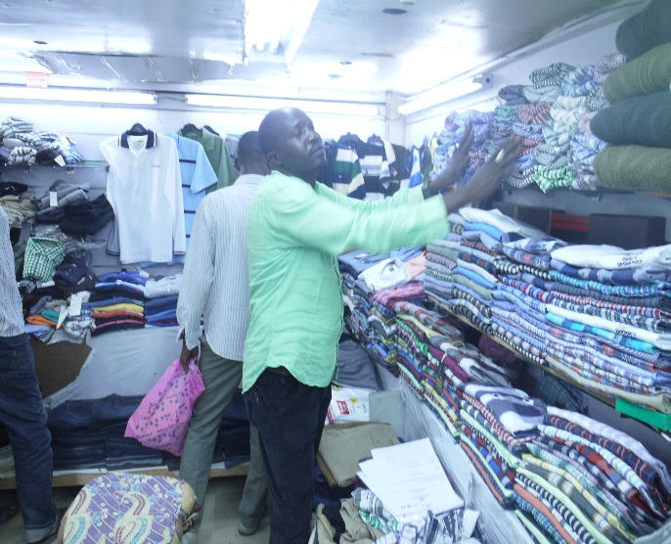

Slide 20
THANK YOU

