Slide 1
Migrasjon
International Organization for Migration

Slide 2
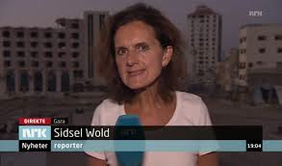
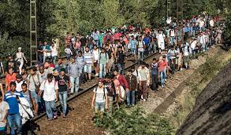
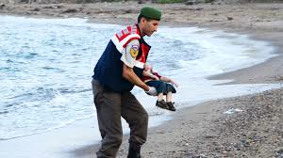
Nyhetsbildet

Slide 3
Noen sentrale begreper
Asylsøker
Flyktning
Kvoteflyktning
Internt fordreven
Irregulær

Slide 4
Definition of “Migrant”
(a) IOM considers a migrant to be any person who is moving or has moved across an international border or within a State away from his/her habitual place of residence, and his/her children, regardless of (1) a person’s legal status; (2) whether the movement is voluntarily or involuntarily; (3) what the causes for the movement are; or (4) what the length of the stay is.
(b) IOM concerns itself with migrants and migration-related issues and, at the request of a State, with migrants who are in need of international migration services.

Slide 5
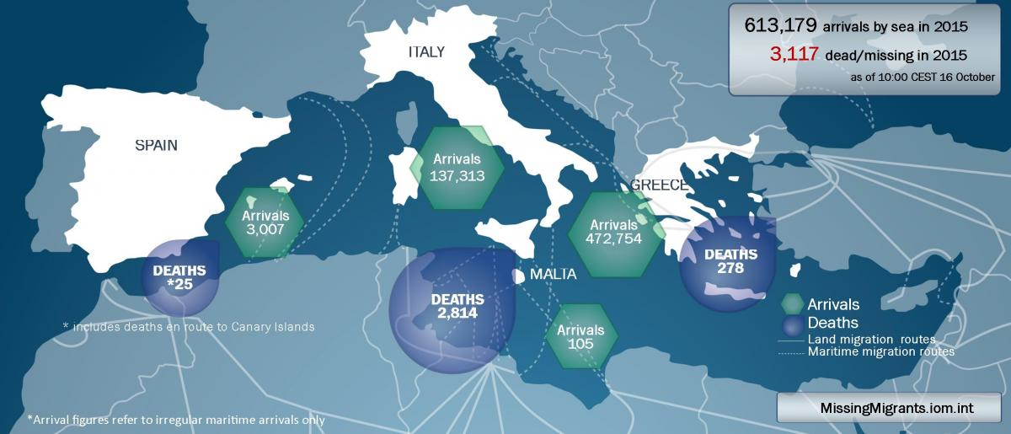
MissingMigrants.iom.int

Slide 6
Kilde: FN og IOM

Slide 7
IOM
Etablert i 1951 med 157 medlemsland
“IOM works in the four broad areas of migration management:
•Migration and development
•Facilitating migration
•Regulating migration
•Forced migration.”

Slide 8
IOM i Norge
Frivillig retur
- Implementert i europeiske land i over 30 år
- VARP siden 2002
- Ulike typer reintegreringsprosjekter siden 2006:
IRRINI/ IRRANA/ ARE/ VG
Kulturorientering
- Over 8000 overføringsflyktninger orientert om Norge siden 2003

Slide 9
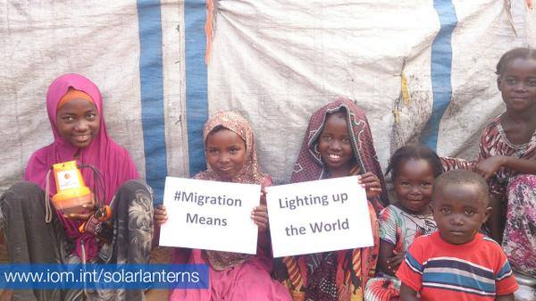
Takk for oppmerksomheten
http://www.iom.no
http://www.iom.int
Facebook og Twitter:
IOM Oslo
International Organization for Migration
- #migrationmeans
http://www.iom.int/world-migration

