Slide 1
Notes:
IOM is the leading inter-governmental organization in the field of migration and works closely with migrants, governmental, intergovernmental and non-governmental partners
IOM is international, working all over the world, with many types of programs for migrants
With 149 member states, a further 12 states holding observer status and offices in over 100 countries
We do not come from the police or UDI /PU / Norwegian government .
We do not represent Government or PU
1

Slide 2
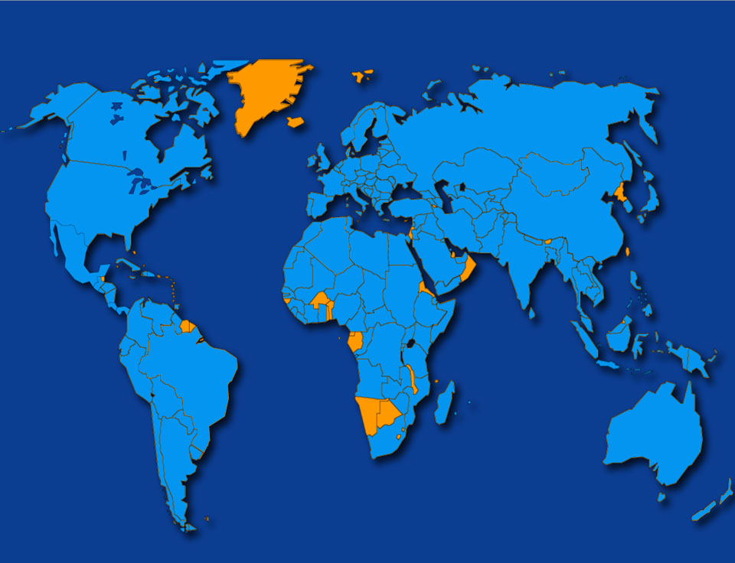
International Organization for Migration
IOM Norway
VARP –
Voluntary Return
I 156 480 kontorer i 156 land
Notes:
2

Slide 3
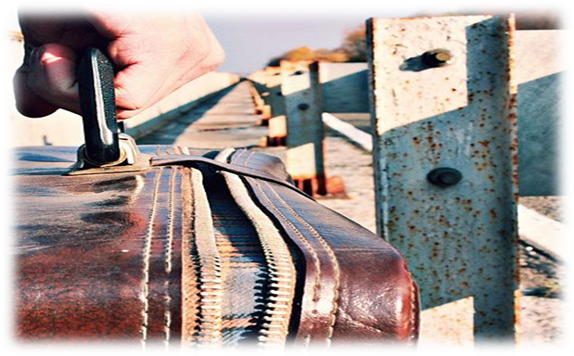
Assistert Frivillig Retur og Reintegrering
Hvem kan returnere?
Asylsøkere
Irregulære migranter
Dublinere
Hvordan er returen?
Human
Planlagt
Organisert
Verdig
3
Notes:
3

Slide 4
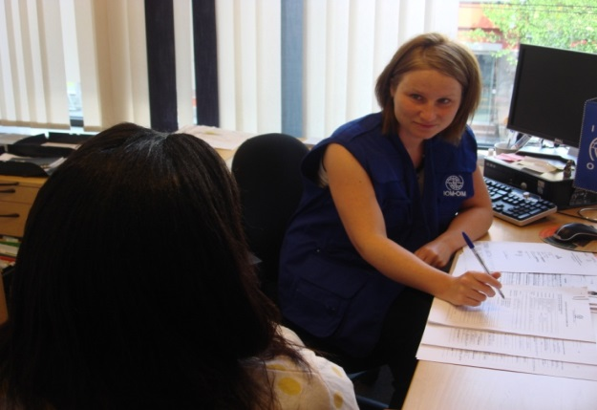
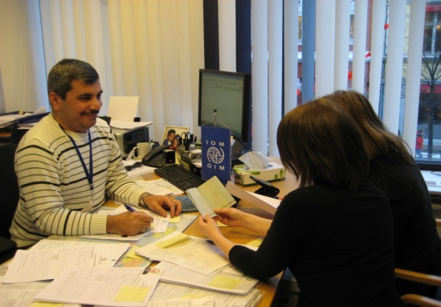
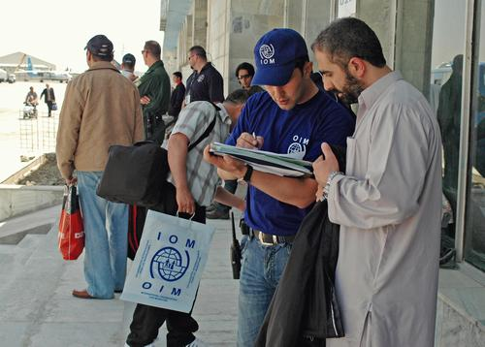
Prepare
Decide to Return
Travel
Reintegration
VARP prosess
Ta et valg
Rådgivning
Reiseplanlegging
Assistanse før og etter avreise

Slide 5
Reasoning for Voluntary Assisted Return
Why seek Voluntary Assisted Return?
You travel as a regular passenger and travel organized to your home town.
Travel notice before departure and transit assistance or escort if required.
Free. Tickets and travel documents and no debt to the Norwegian government.
Assistance in acquiring travel documents.
IOM can assist upon arrival.
Possibility of reintegration support.
You take control of your life and your future.
5
Notes:
5

Slide 6
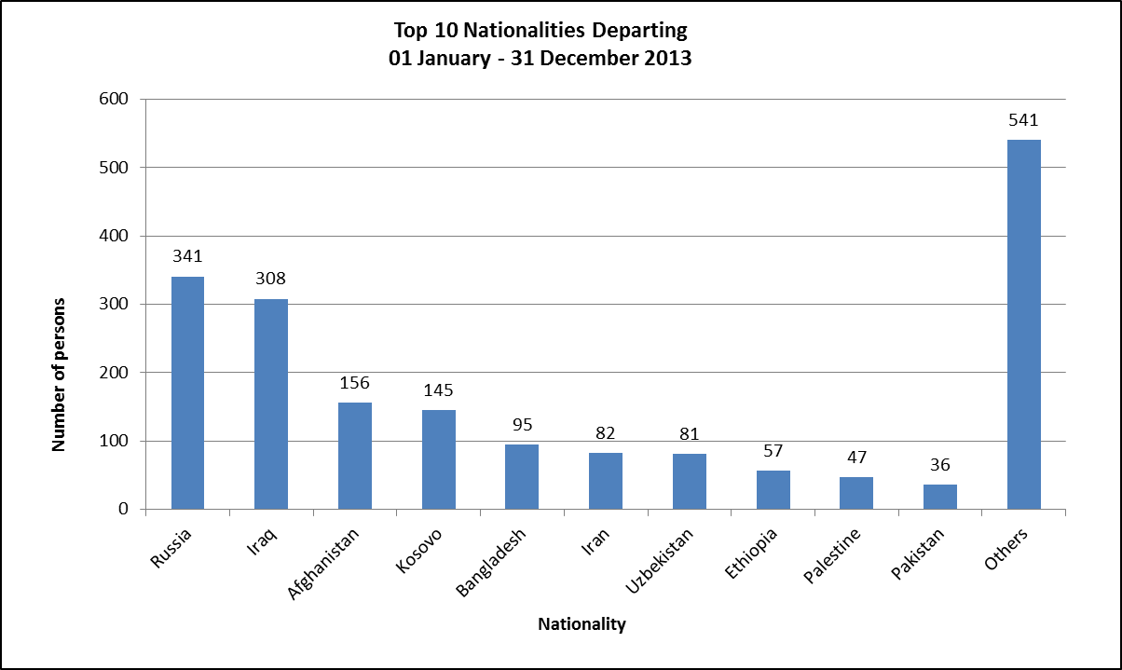
Hvem reiser hjem med IOM?
Hvem reiser hjem frivillig?
1889 mennesker returnerte med IOM Oslo i 2013
6
Notes:
6

Slide 7
Hvem reiser hjem med IOM?
Januar – Desember 2014
Afghanistan | 207
Russia | 189
Bangladesh | 171
Iraq | 159
Uzbekistan | 135
Iran | 83
Ethiopia | 57
Sudan | 44
Nigera | 43
Kosovo | 42

Slide 8
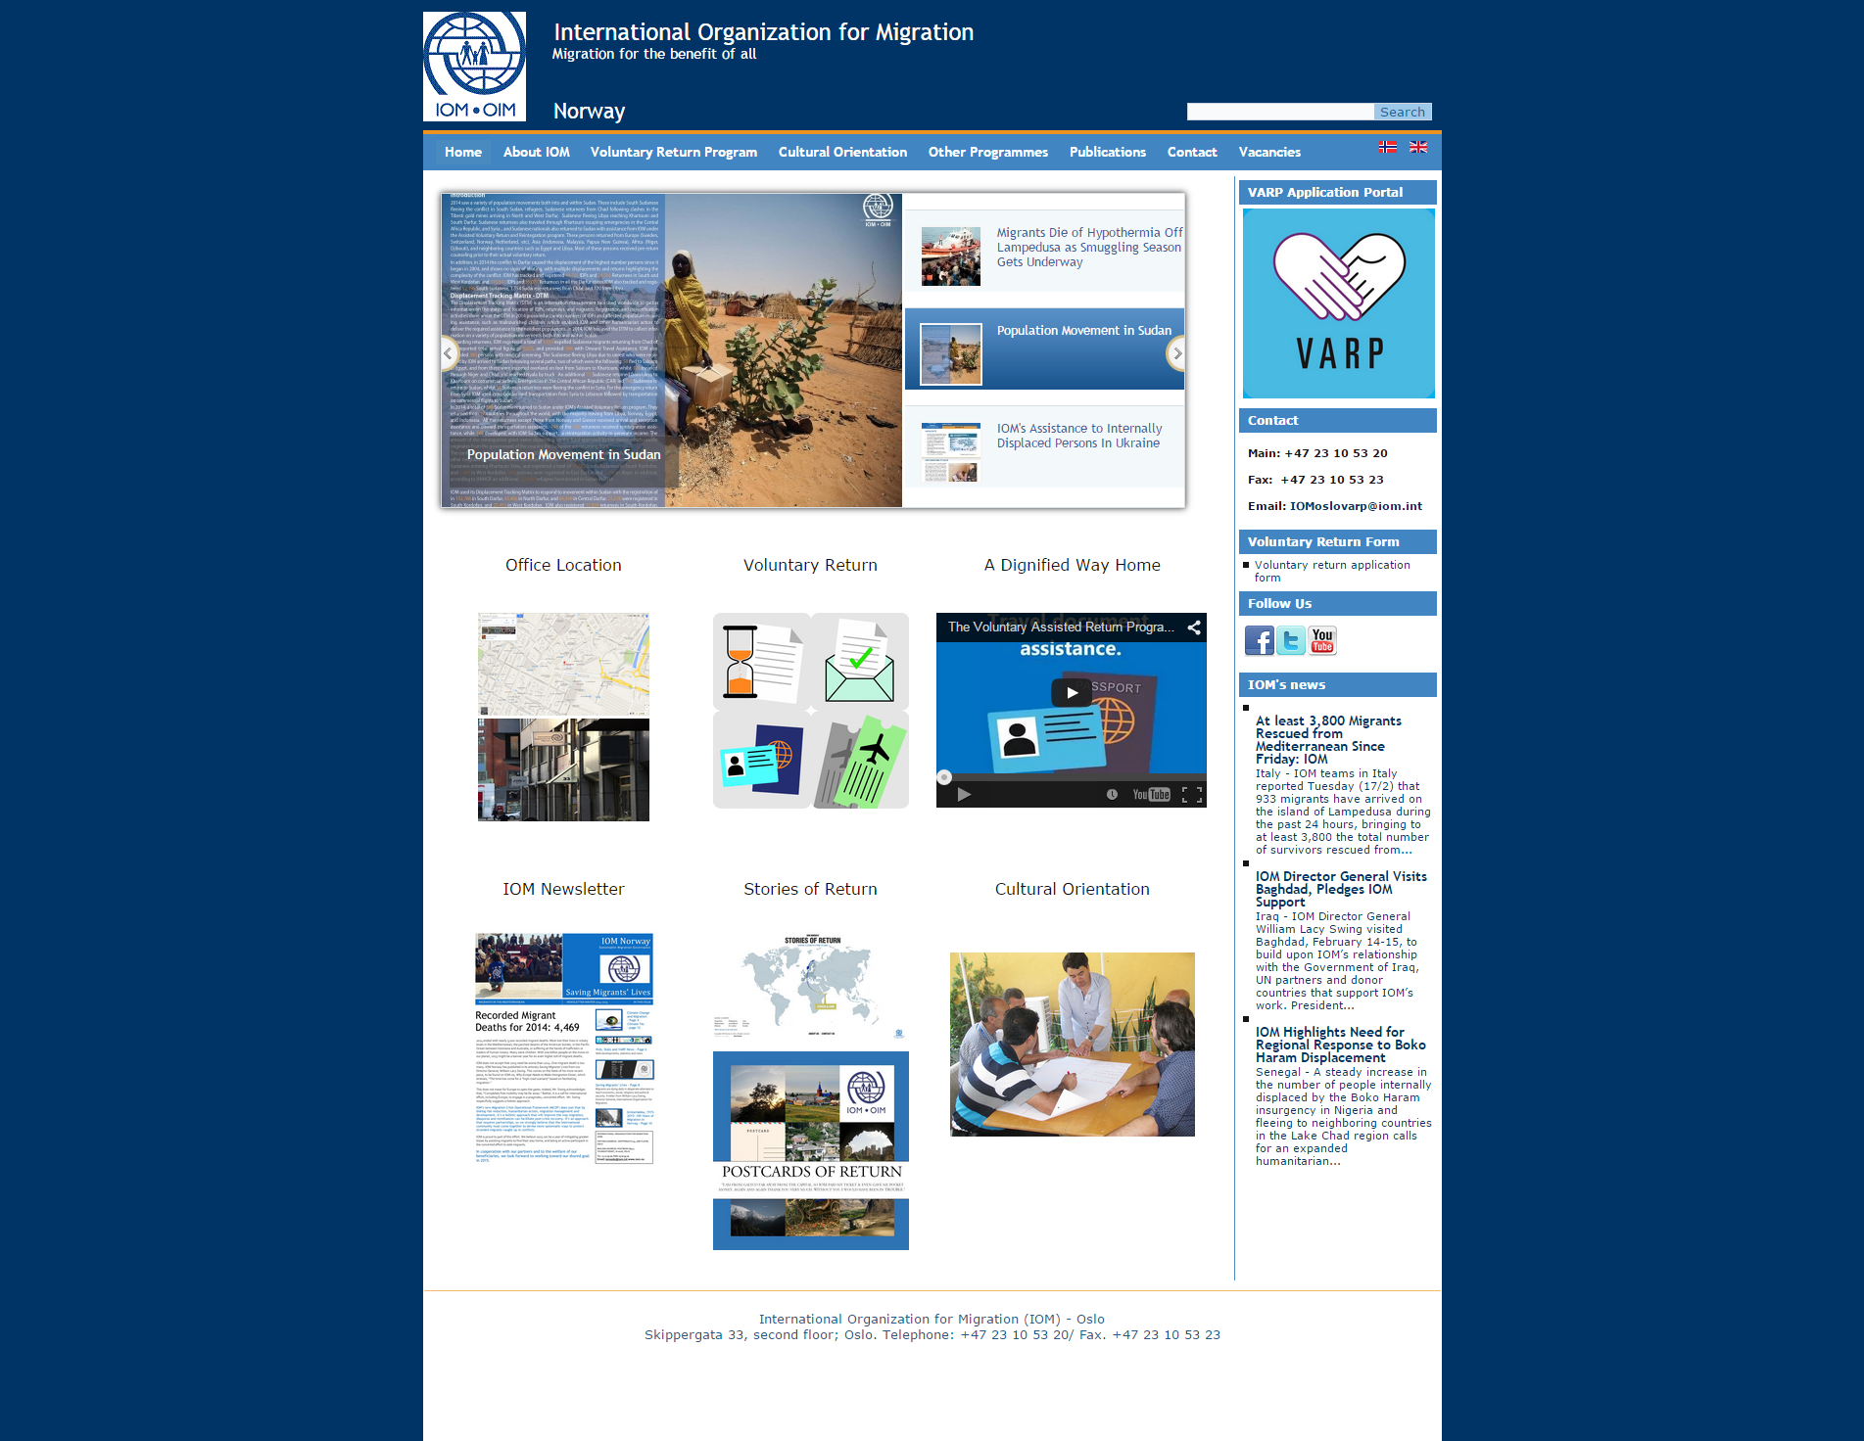
iom.no
www.iom.no
www.iom.no
Notes:
8

Slide 9
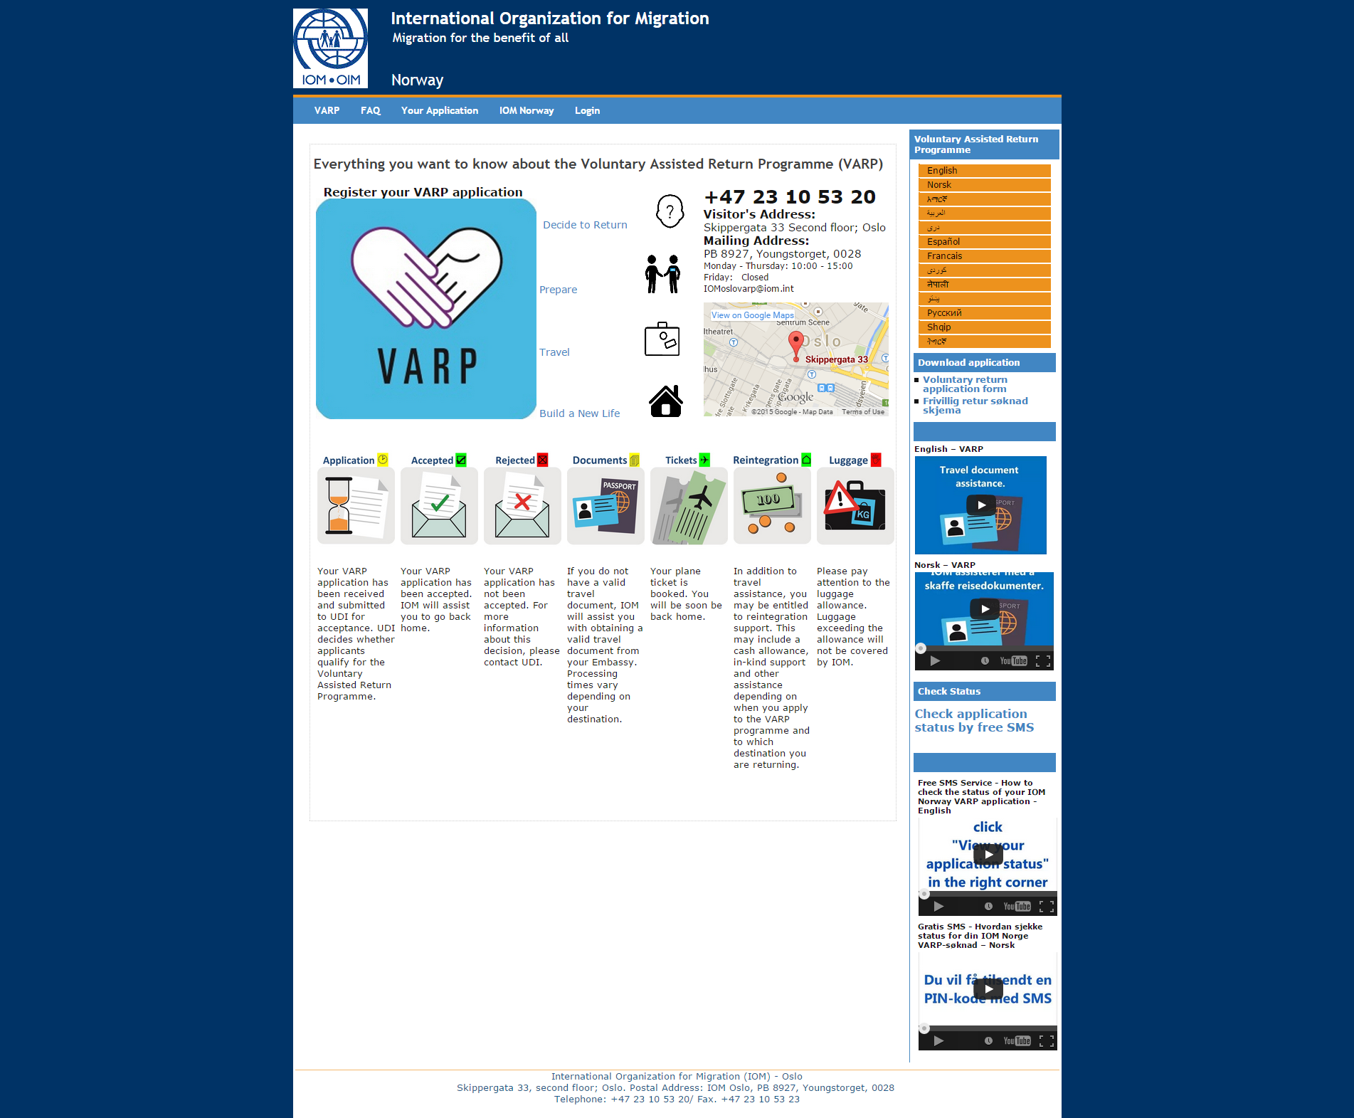
voluntaryreturn.com

Slide 10
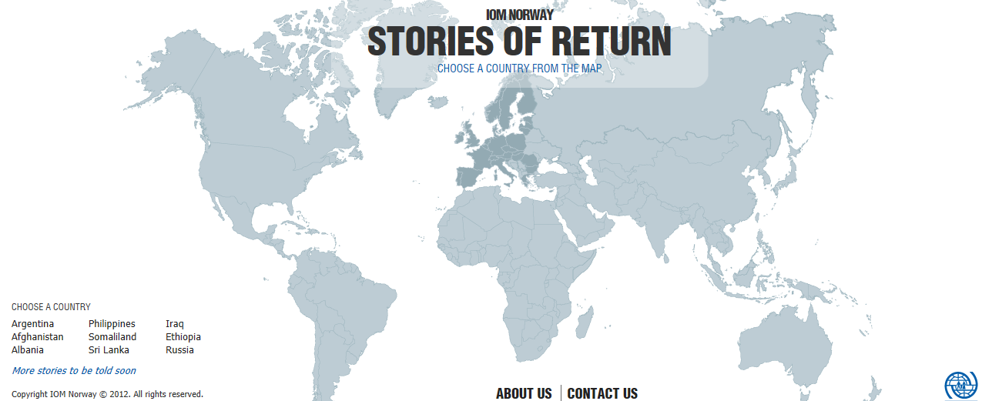
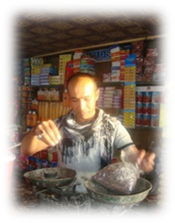
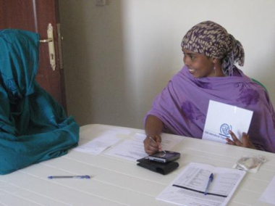
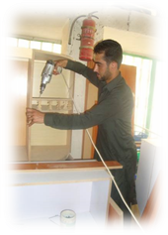
www.iomstoriesofreturnnorway.com
Notes:
10
Mange årsaker til retur:
Mange historier til de som reiste hjem med IOM: motivasjon og beslutningsprosess når asylsøkere (migranter) velger frivillif retur
10

Slide 11
For mer informasjon
IOM Skippergata 33 Oslo
www.iom.no
www.voluntaryreturn.com
IOMosloVARP@iom.int
Telefon: 800-37484
Notes:
11
Please mention the opening hours and our availability if they want to come and see us in person. No appointment is needed during opening hours.
This was just information and if you need more details, please contact us again.

